Slide 1
Synthetic Data for Defect Segmentation on
Complex Metal Surfaces
Juraj Fulir, Lovro Bosnar, Hans Hagen, Petra Gospodnetić
CVPR 2023 - VISION Workshop

Slide 2
Introduction
Defects are diverse and rare → Data shortage

Slide 3
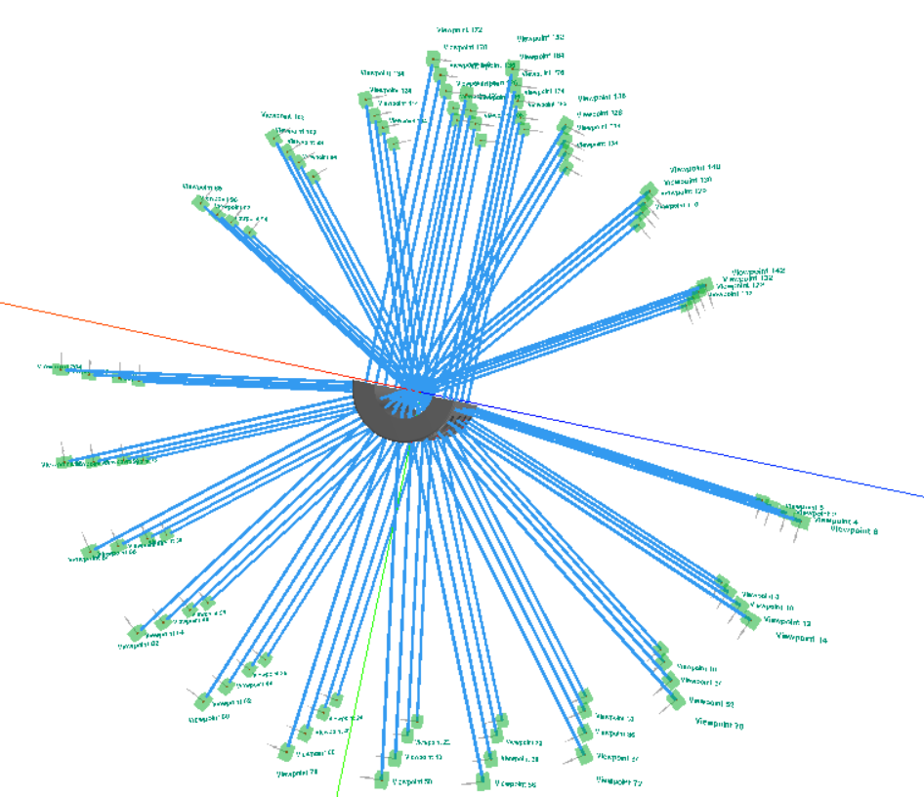
Introduction
Defects are diverse and rare → Data shortage
Complex geometry → Complex inspection setups

Slide 4
Introduction
Defects are diverse and rare → Data shortage
Complex geometry → Complex inspection setups
Textured metal surfaces are challenging
Honzátko, D. et.al.: Defect segmentation for multi-illumination quality control systems (2021)

Slide 5
Existing research
Large datasets, but planar geometry
PAO Severstal: Severstal: Steel defect detection (2019)

Slide 6
Existing research
Large datasets, but planar geometry
Curved geometry, but uncontrolled environment
Zhang Z. et. al.: Rail-5k: a Real-World Dataset for Rail Surface Defects Detection (2021)
PAO Severstal: Severstal: Steel defect detection (2019)

Slide 7
Existing research
Large datasets, but planar geometry
Curved geometry, but uncontrolled environment
Complex geometry, but flat surface texture
Zhang Z. et. al.: Rail-5k: a Real-World Dataset for Rail Surface Defects Detection (2021)
PAO Severstal: Severstal: Steel defect detection (2019)
Schlagenhauf T. et. al.: Industrial Machine Tool Component Surface Defect Dataset (2021)

Slide 8
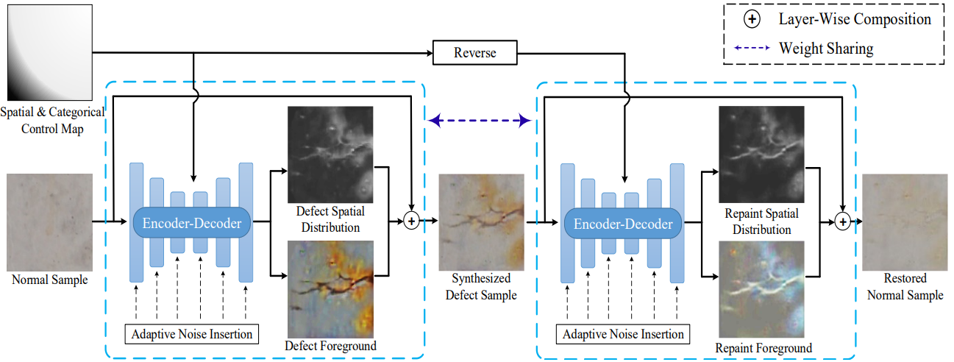
Existing research
Trained generative models for data generation is problematic:
Requires data with a lot of variety
Difficult to guarantee image quality
Difficult to extend support while preserving existing
Zhang G. et. al.: Defect-GAN: High-Fidelity Defect Synthesis for Automated Defect Inspection (2021)

Slide 9
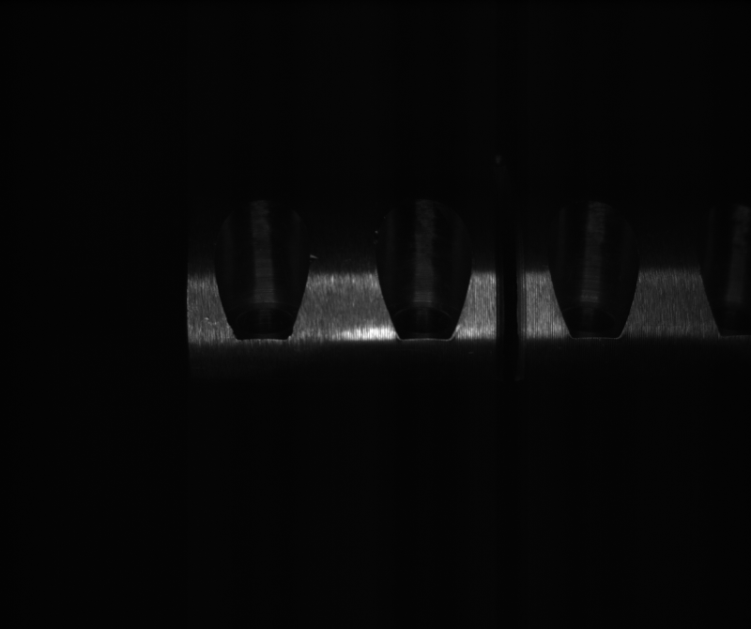
Our contributions
New dataset for defect recognition → complex surface geometry and texture
Real data →

Slide 10
Our contributions
New dataset for defect recognition → complex surface geometry and texture
Synthetic dataset equivalent → using recent procedural methods by Bosnar et.al.
Real data →
← Synth data

Slide 11
Our contributions
New dataset for defect recognition → complex surface geometry and texture
Synthetic dataset equivalent → using recent procedural methods by Bosnar et.al.
Comparative study: custom synthetic data or similar datasets
Real data →
← Synth data

Slide 12
Our contributions
New dataset for defect recognition → complex surface geometry and texture
Synthetic dataset equivalent → using recent procedural methods by Bosnar et.al.
Comparative study: custom synthetic data or similar datasets
Methods for improving model performance
Real data →
← Synth data

Slide 13
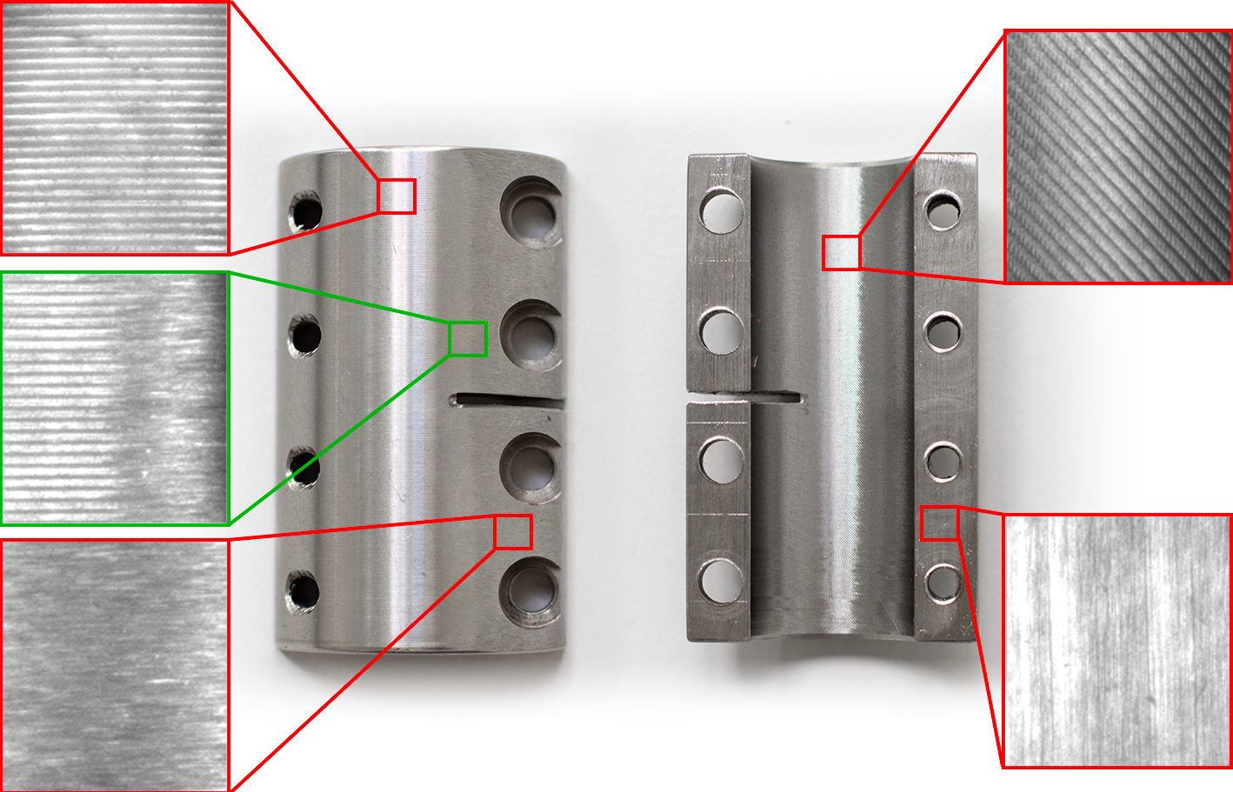
RealClutch dataset
Description
6 objects, 3 manually defected
4 distinct surface textures
2 variations of inner milling texture
Acquisition in dark environment
516 images (grayscale)
Manually annotated only significant defects
Goal
Image segmentation of significant defects

Slide 14
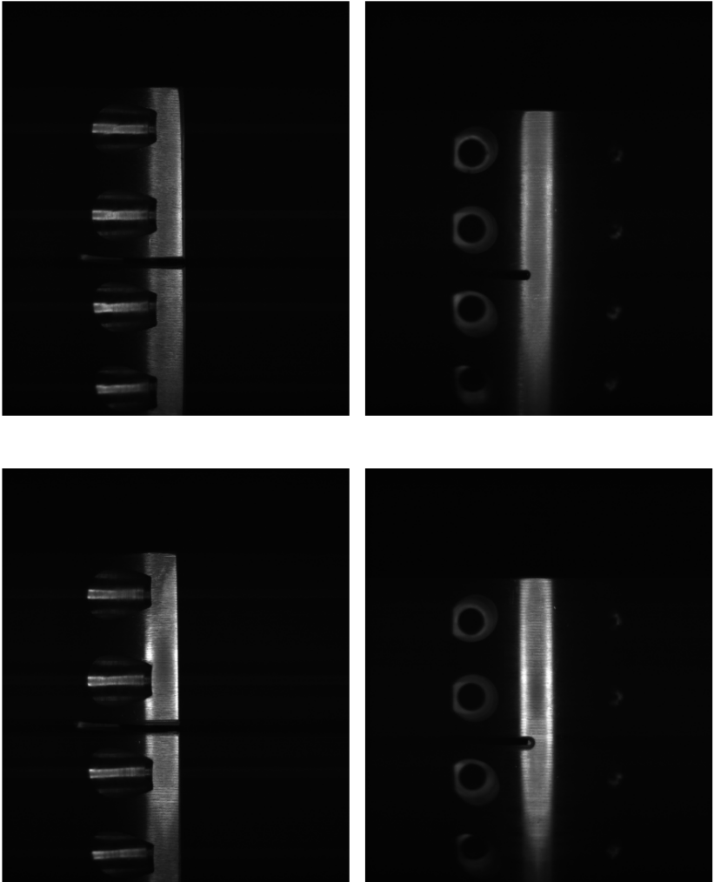
Random cropping
Image sample 1
Image sample 2
Large images (halved to 1224x1025)

Slide 15
Random cropping
Image sample 1
Image sample 2
Large images (halved to 1224x1025)
Many random crops end up in dark regions (background)

Slide 16
Random cropping
Image
Thresholded
Large images (halved to 1224x1025)
Many random crops end up in dark regions (background)
Bias cropping to higher intensities

Slide 17
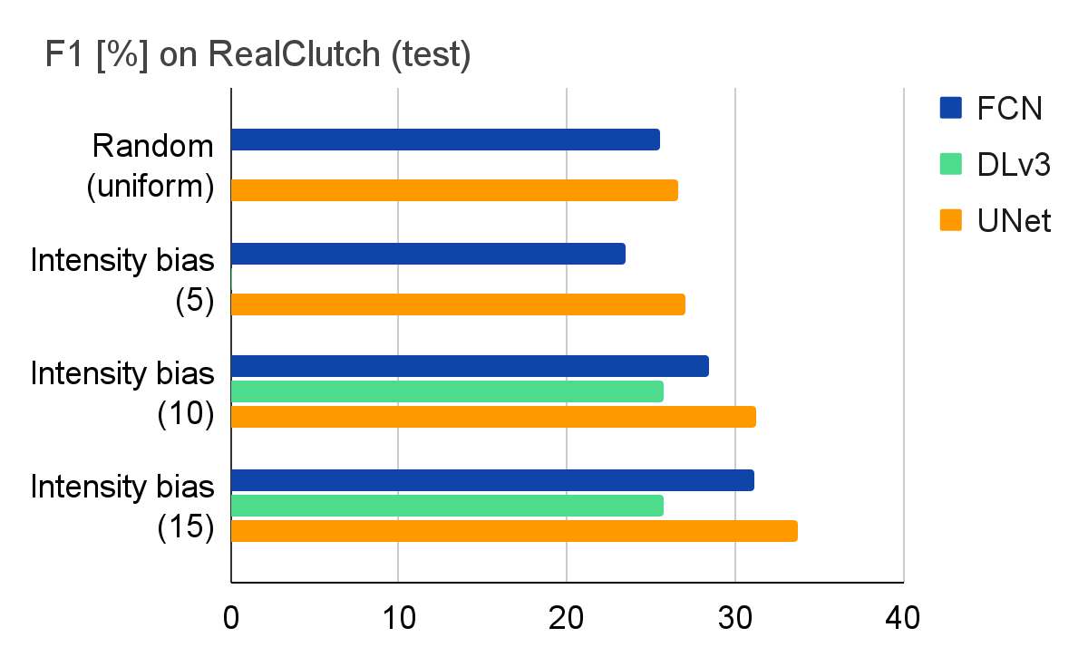
Random cropping
Image
Thresholded
Large images (halved to 1224x1025)
Many random crops end up in dark regions (background)
Bias cropping to higher intensities
Higher performance and stability

Slide 18
Comparative study

Slide 19
Comparative study
Similarities:
- Defect shapes and material
- Surface material
- Shadowing effect of curved surfaces
- Complex geometry and multiple textures
- Defect visibility changes
- Similar geometry and acquisition setup

Slide 20
Comparative study - DAGM
Similarities:
- Defect shapes and material
- Surface material
- Shadowing effect of curved surfaces
- Complex geometry and multiple textures
- Defect visibility changes
- Similar geometry and acquisition setup
Wieler M. et. al.: Weakly supervised learning for industrial optical inspection (2007)

Slide 21
Comparative study - Kolektor Surface Defects Dataset v2
Similarities:
+ Defect shapes and material
- Surface material
- Shadowing effect of curved surfaces
- Complex geometry and multiple textures
- Defect visibility changes
- Similar geometry and acquisition setup
Božič J. et. al.: Mixed supervision for surface-defect detection: from weakly to fully supervised learning (2021)

Slide 22
Comparative study - Severstal Steel dataset
Similarities:
+ Defect shapes and material
+ Surface material
- Shadowing effect of curved surfaces
- Complex geometry and multiple textures
- Defect visibility changes
- Similar geometry and acquisition setup
PAO Severstal: Severstal: Steel Defect Detection (2019)

Slide 23
Comparative study - Magnetic Tile Defects dataset
Similarities:
+ Defect shapes and material
+ Surface material
+ Shadowing effect of curved surfaces
- Complex geometry and multiple textures
- Defect visibility changes
- Similar geometry and acquisition setup
Huang Y. et. al.: Surface defect saliency of magnetic tile (2018)

Slide 24
Comparative study - CSEM Multi Illumination Surface Defect detection dataset
Similarities:
+ Defect shapes and material
+ Surface material
+ Shadowing effect of curved surfaces
+ Complex geometry and multiple textures
+ Defect visibility changes
- Similar geometry and acquisition setup
Honzátko, D. et.al.: Defect segmentation for multi-illumination quality control systems (2021)

Slide 25
Comparative study - SynthClutch
Similarities:
+ Defect shapes and material
+ Surface material
+ Shadowing effect of curved surfaces
+ Complex geometry and multiple textures
+ Defect visibility changes
+ Similar geometry and acquisition setup

Slide 26
SynthClutch dataset
Description
40 objects, procedurally defected and textured CAD model
Defect, material and texture parameters sampled within specified ranges
3440 rendered images (grayscale)
Rendered with segmentation annotations
L. Bosnar et.al.: Image synthesis pipeline for surface inspection (2020)
L. Bosnar et.al.: Texture synthesis for surface inspection (2022)
L. Bosnar et.al.: Procedural defect modeling for virtual surface inspection environments (2023)

Slide 27
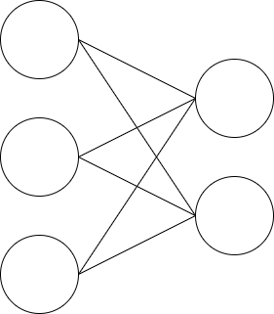
Results
Training:
Source data (train/val subset)

Slide 28
Results
Training:
Testing:
Source data (train/val subset)
RealClutch (test subset)

Slide 29
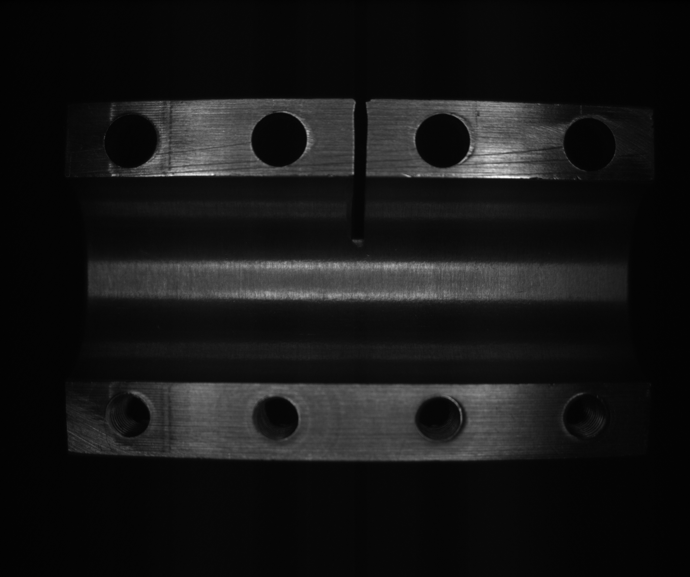
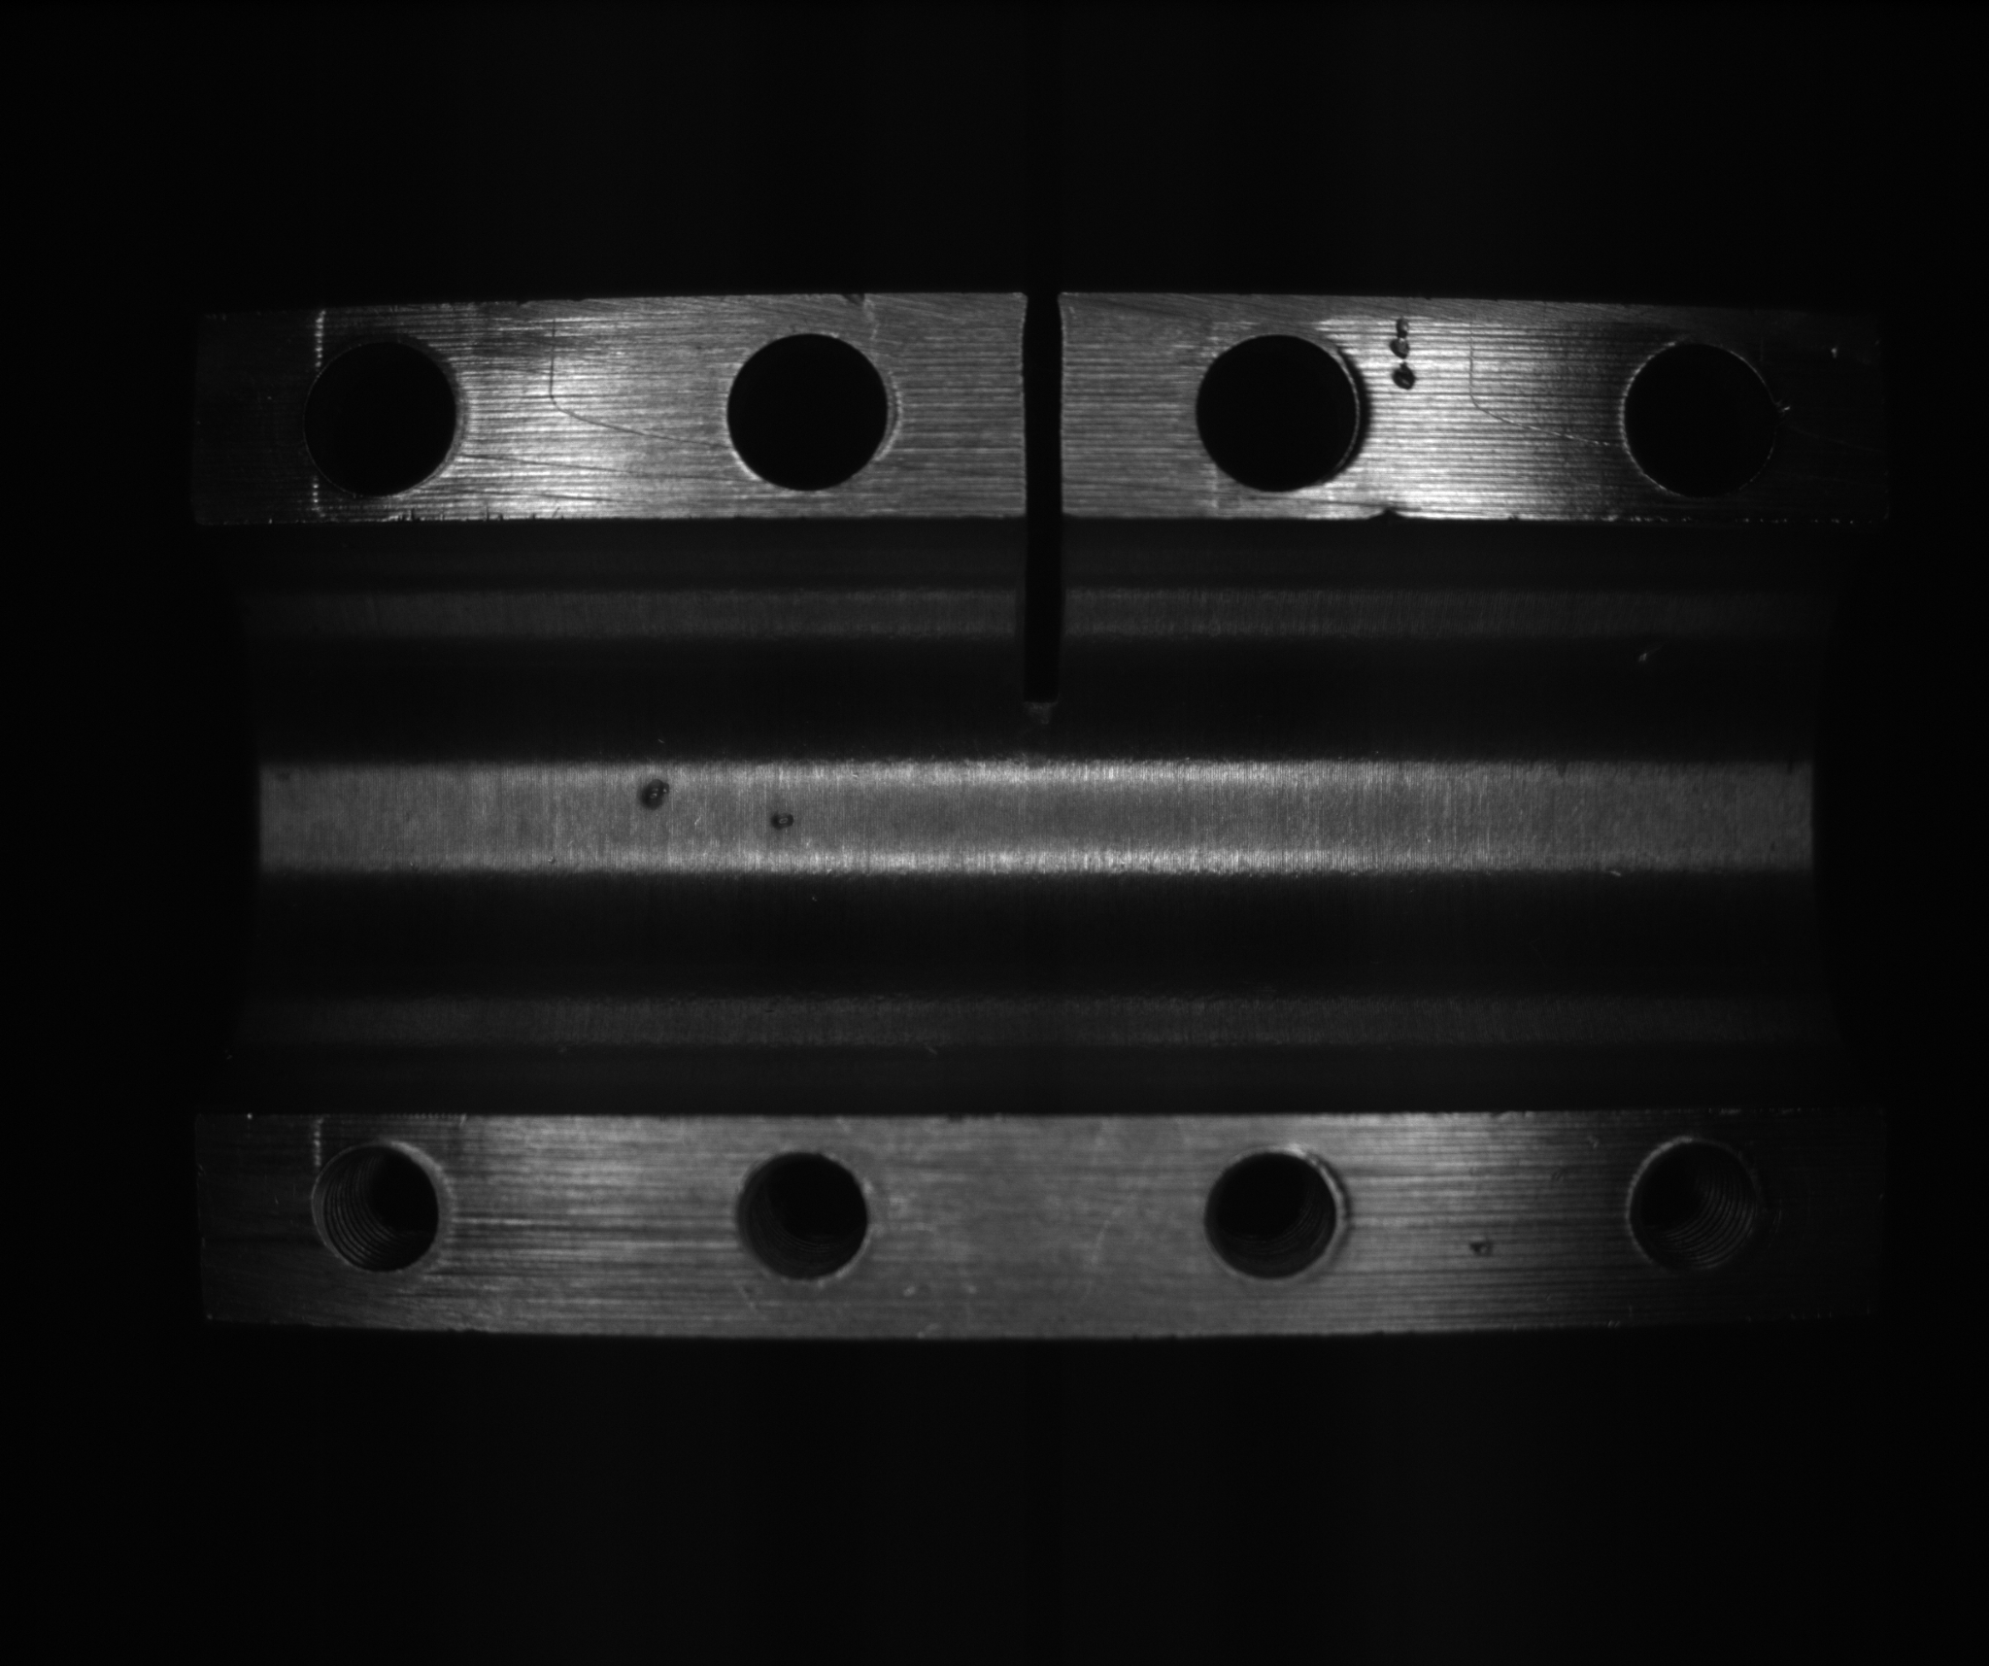
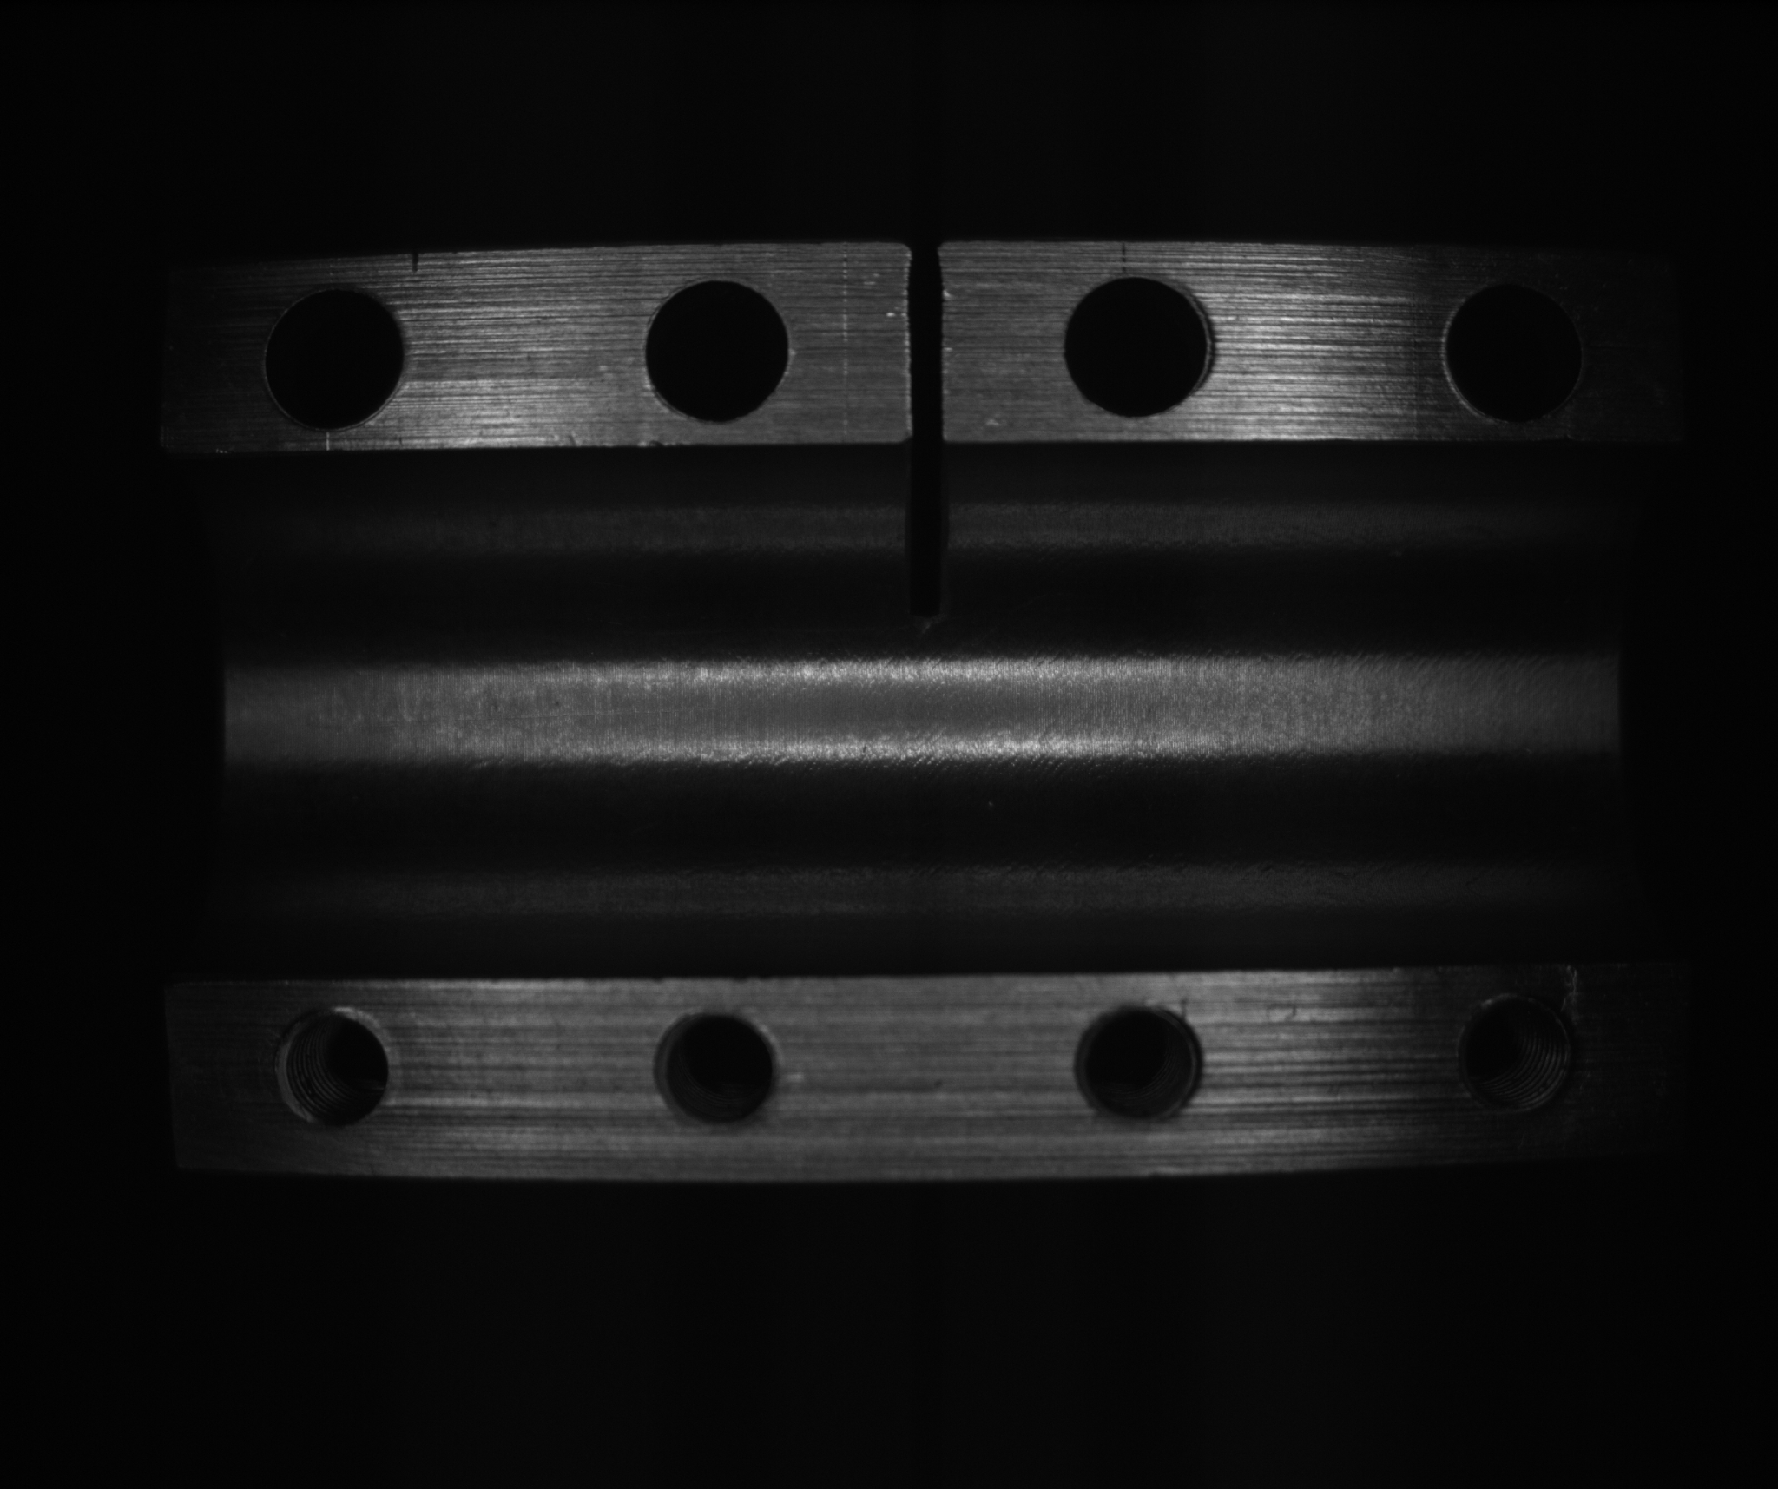
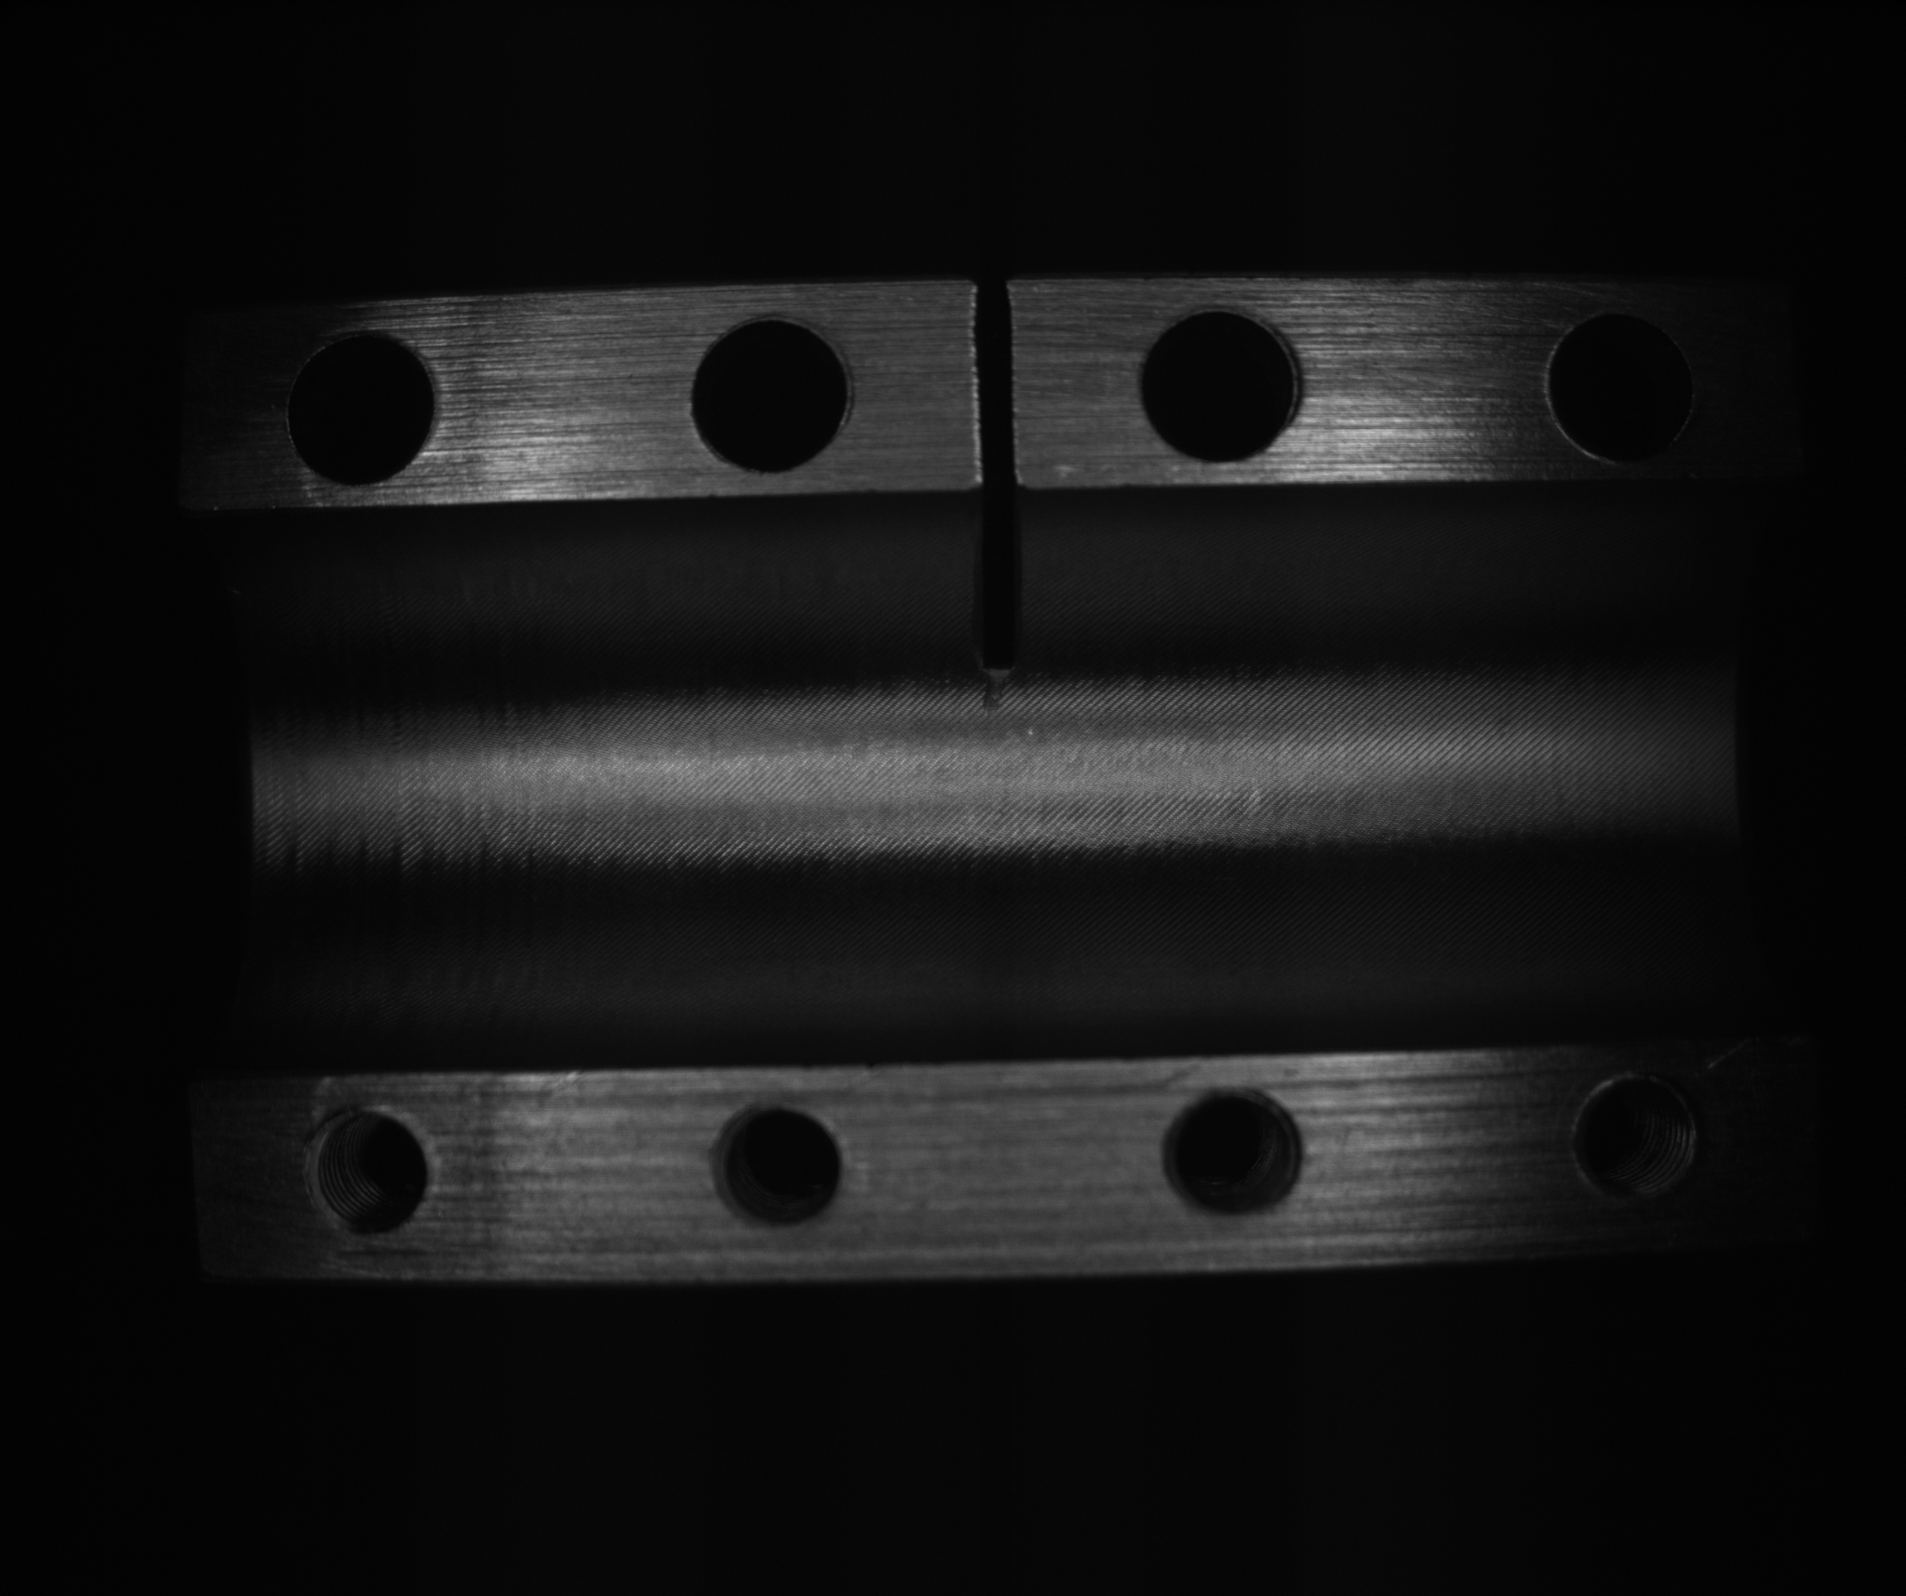
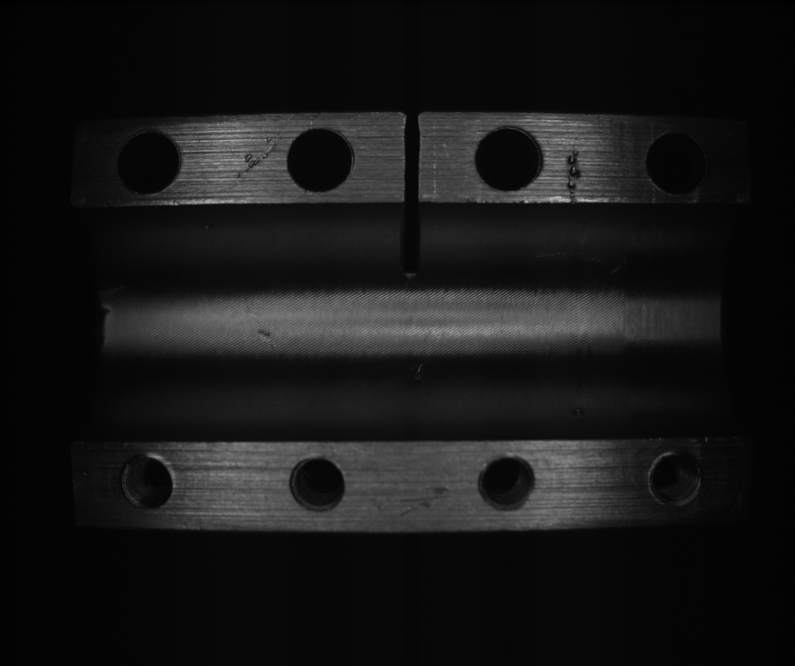
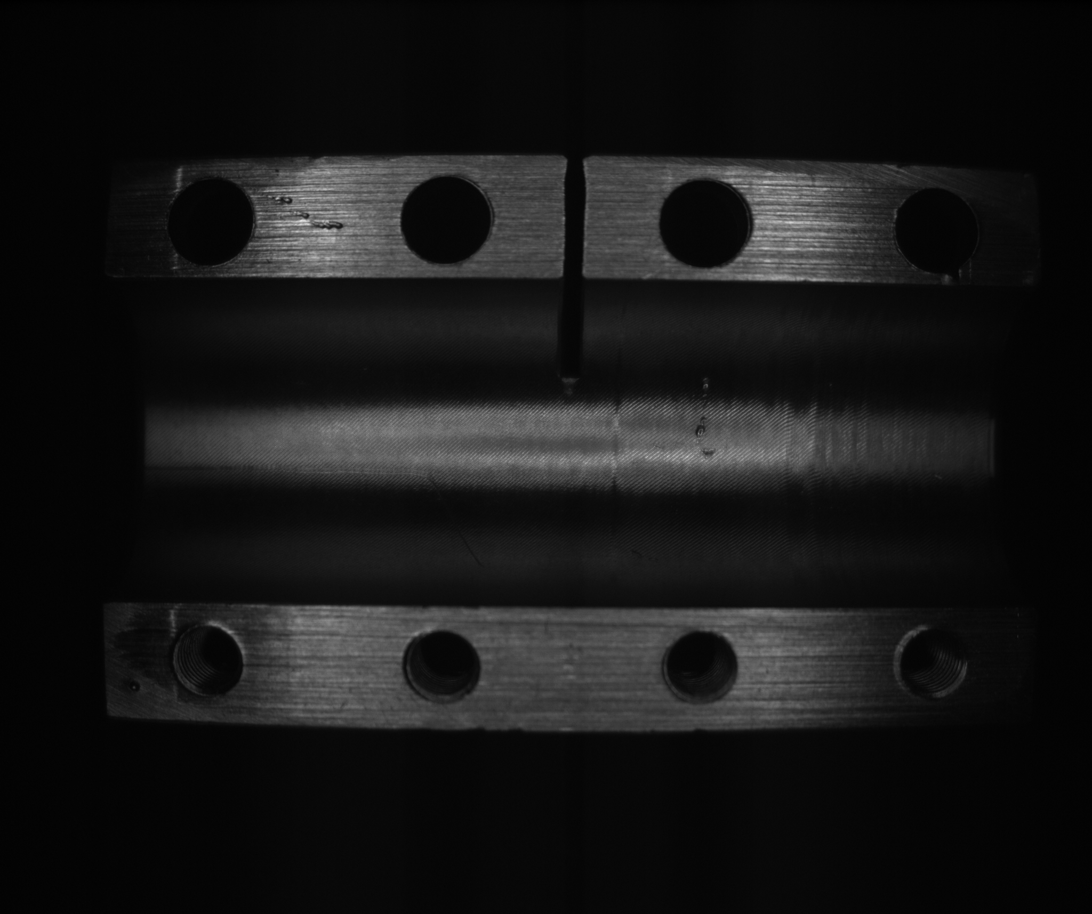
Results
Training:
Testing:
Source data (train/val subset)
RealClutch (test subset)
Train
Test

Slide 30
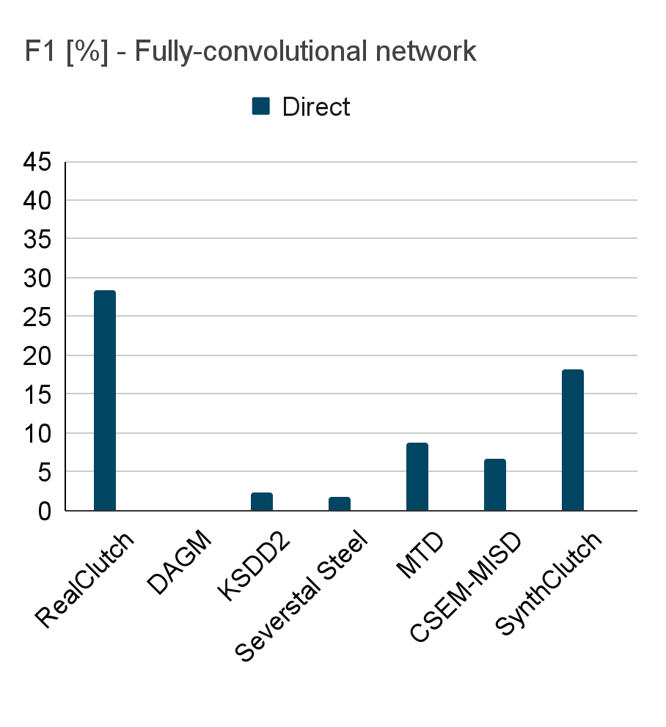
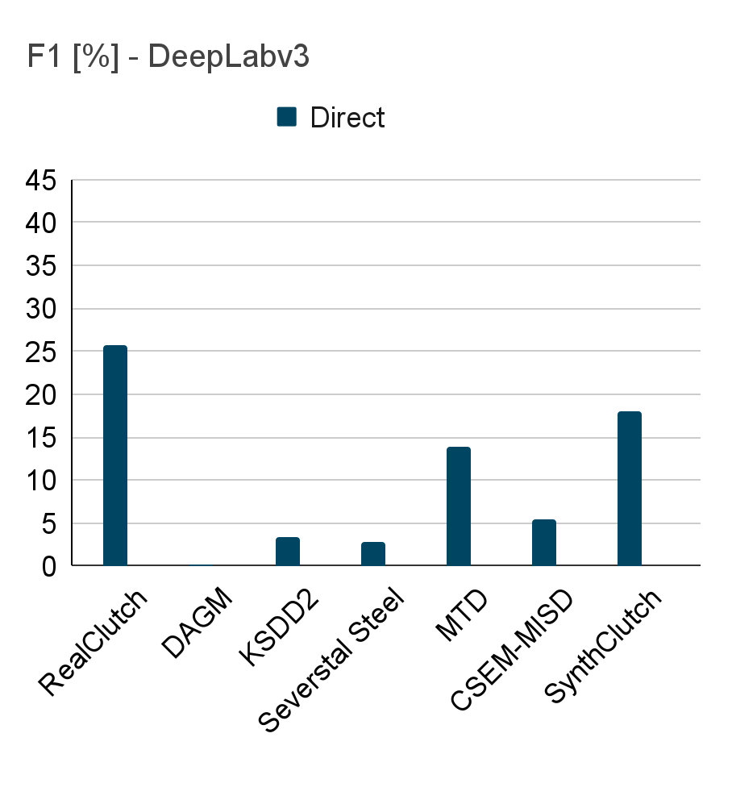
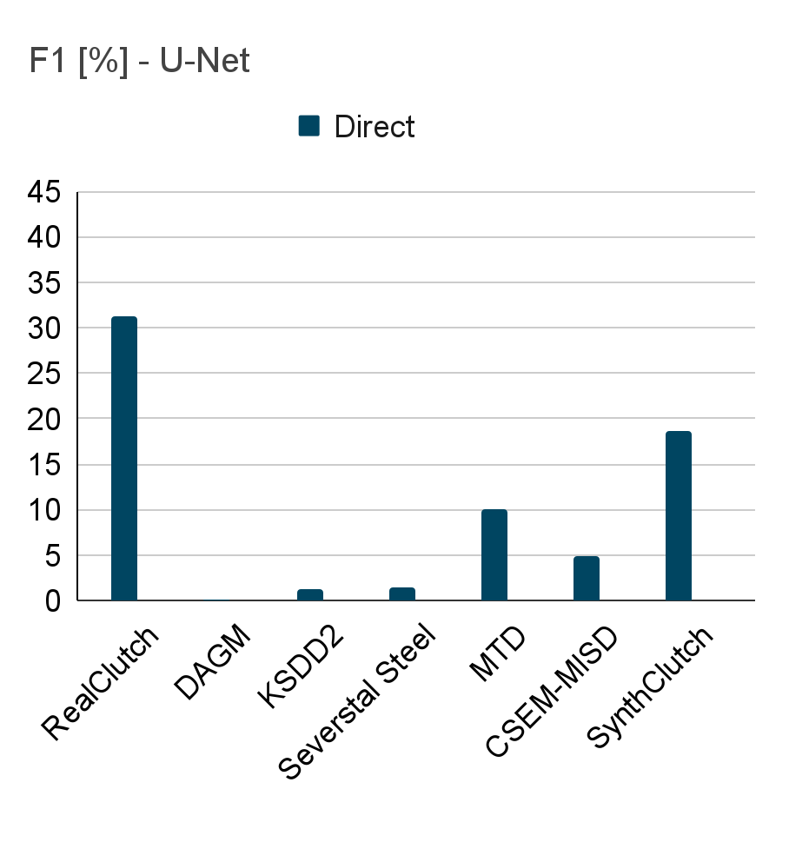
Results - Baseline

Slide 31
Results - Related datasets

Slide 32
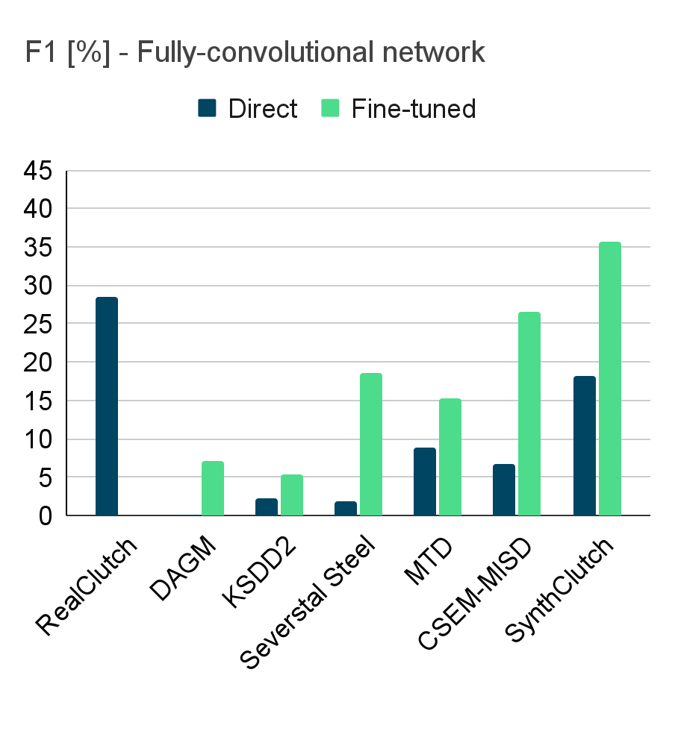
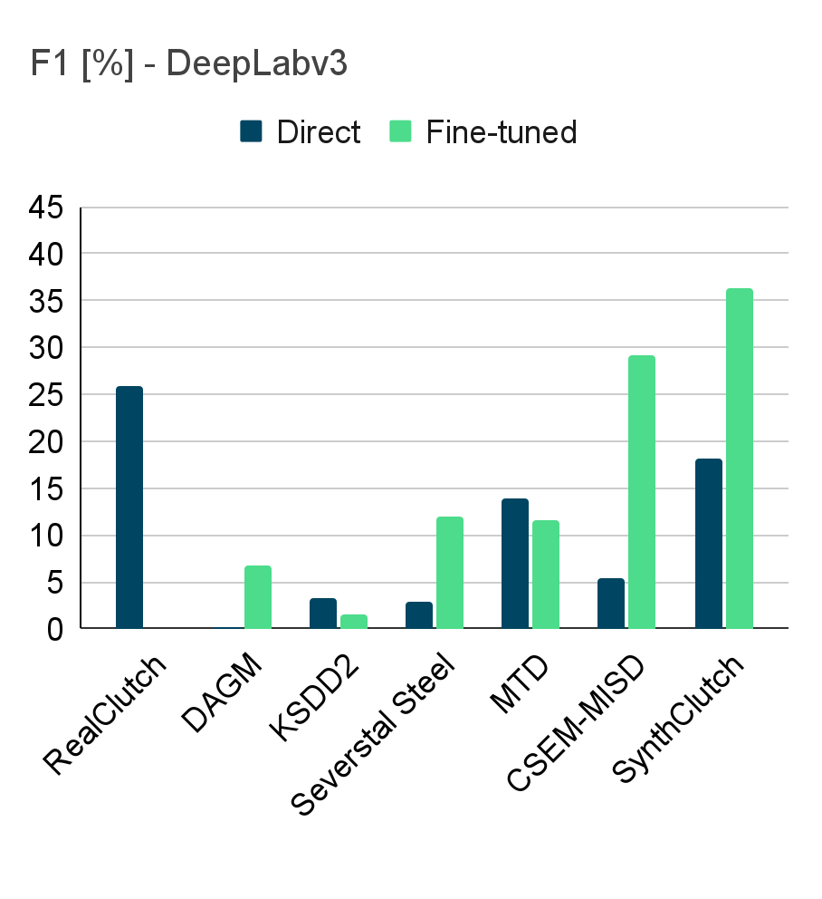
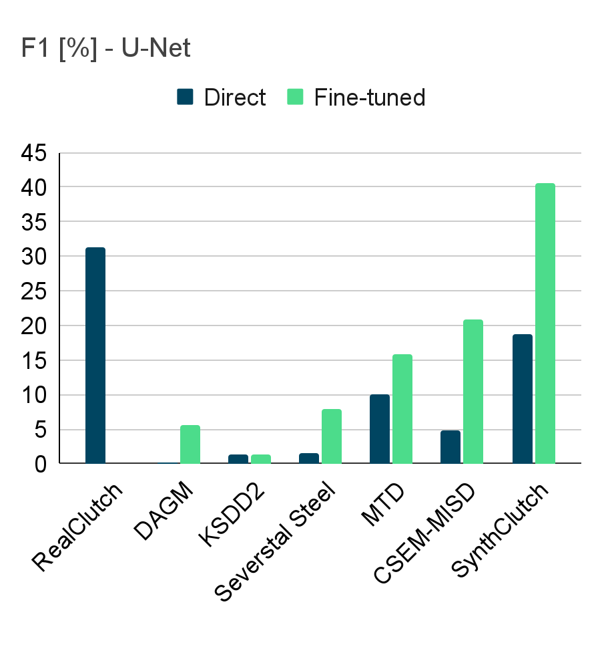
Results - Related datasets + Fine-tuning

Slide 33
Results - SynthClutch

Slide 34
Results - Performance trend

Slide 35
Results - Domain gap

Slide 36
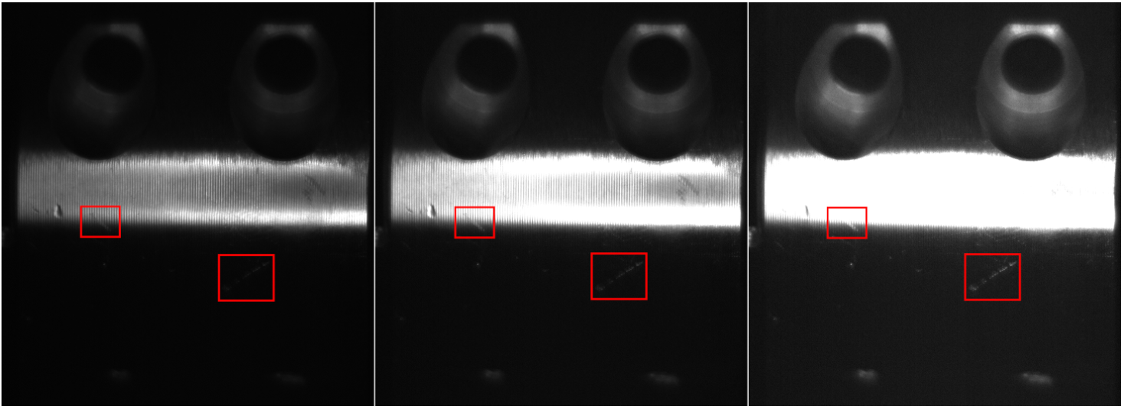
Exposure stacking - Defect appearance change
Original
Exposure 1
Exposure 2

Slide 37
Exposure stacking - Defect appearance change
Original
Exposure 1
Exposure 2

Slide 38
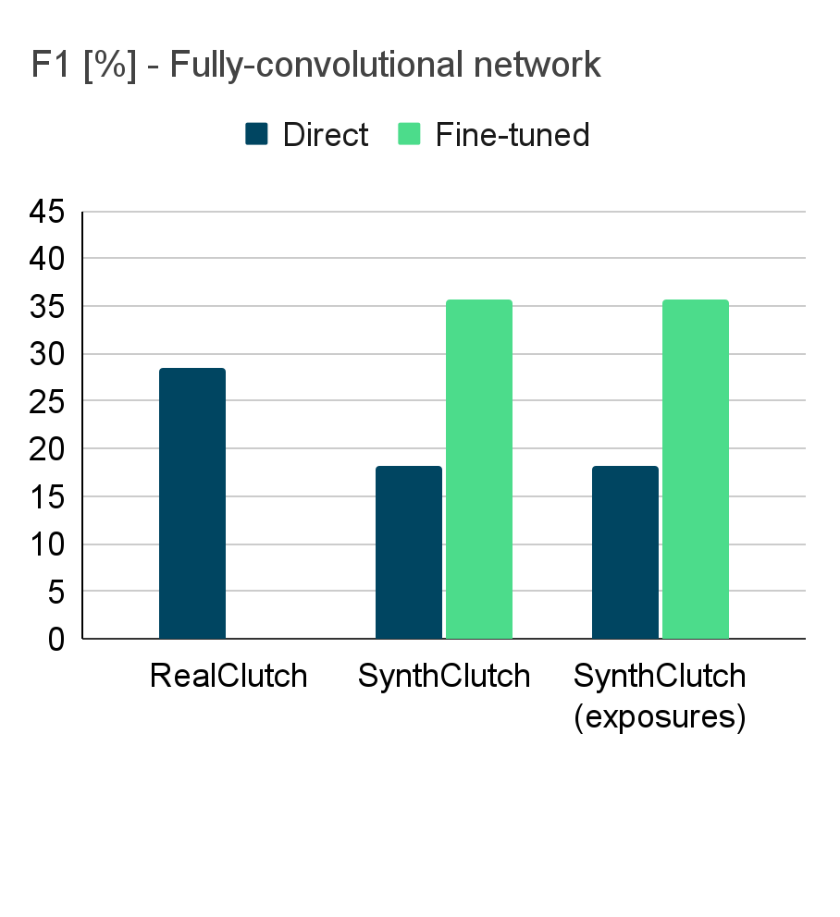
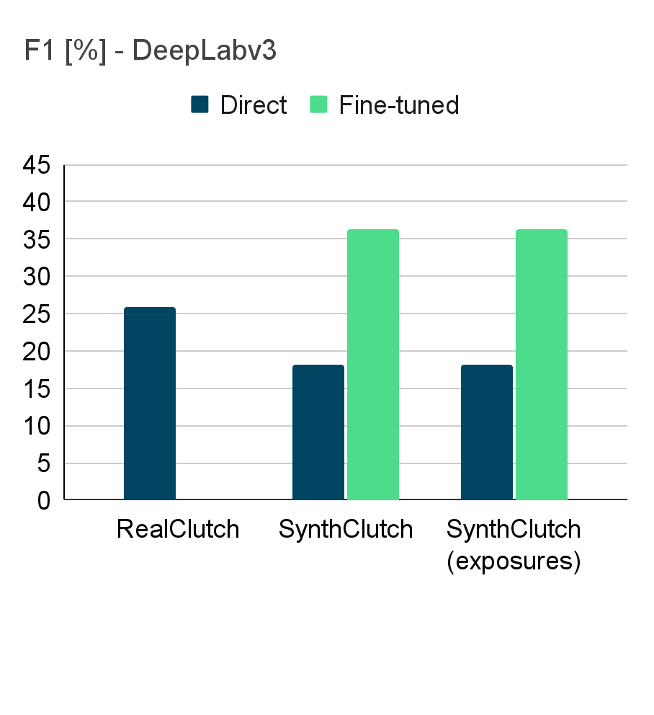
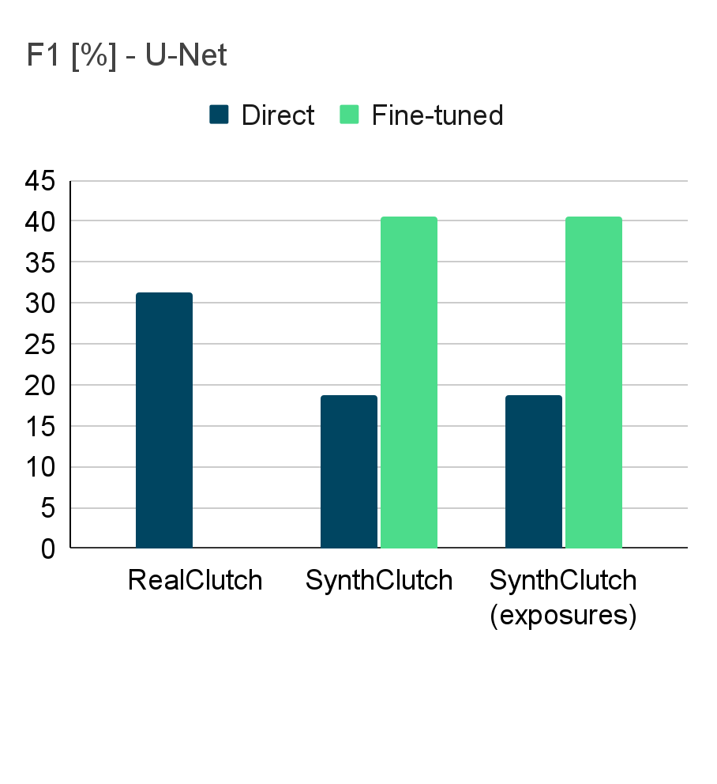
Exposure stacking - Results
~
~
~

Slide 39
Conclusions
Introduced a new dual dataset for surface inspection

Slide 40
Conclusions
Introduced a new dual dataset for surface inspection
Custom synthetic dataset is superior to similar datasets

Slide 41
Conclusions
Introduced a new dual dataset for surface inspection
Custom synthetic dataset is superior to similar datasets
Small amount of real data is still needed

Slide 42
Conclusions
Introduced a new dual dataset for surface inspection
Custom synthetic dataset is superior to similar datasets
Small amount of real data is still needed
Intensity biased cropping benefits the learning process

Slide 43
Conclusions
Introduced a new dual dataset for surface inspection
Custom synthetic dataset is superior to similar datasets
Small amount of real data is still needed
Intensity biased cropping benefits the learning process
Stack of modified exposures does not increase model performance

Slide 44
Limitations and further research
Synthetic masks are over-labeling
Mask
Image
Overexposed image

Slide 45
Limitations and further research
Synthetic masks are over-labeling
Problem of defect visibility
Mask
Image
Overexposed image

Slide 46
Limitations and further research
Synthetic masks are over-labeling
Problem of defect visibility
Decision making based on single image
?

Slide 47
Limitations and further research
Synthetic masks are over-labeling
Problem of defect visibility
Decision making based on single image
Exploring the possibilities of procedural synthetic data in different industrial inspection setups
?

Slide 48
Thank you for listening!
This work was supported by Fraunhofer ITWM and the German Federal Ministry of Education and Research (BMBF) [grant number 01IS21058B (SynosIs)].
We thank Maedler for providing us with the correct object samples and consent to use them for research.

Slide 49
Extra slides

Slide 50
RealClutch dataset

Slide 51
SynthClutch dataset

Slide 52
Introduction
Defect recognition approaches | Expensive annotation | Requires lot of defect data | Requires lot of correct data
Supervised (detection, segmentation) | + | + | +
Weakly-supervised (class activation maps) | - | + | +
Anomaly detection | - | - | +
CVPR 2023 - VISION Workshop

